Slide 1


Problem Solving with the Internet of Things and Python
Unit 1
Notes:
Note from Doug. If you are using these materials, you can remove the CWRU logo and replace it with your own, but please retain the CC-BY logo on the first page as well as retain the acknowledgements page(s).

Slide 2
Unit 1 Topics
1.1 What is IOT? What is a Thing?
1.2 IOT Connectivity
1.3 IOT Communication Protocols
1.4 IOT Services
1.5 IOT Security

Slide 3
Unit 1.1
What is IOT? What is a thing?
Notes:
The big idea of Unit 1 is to introduce the student to the Internet of Things. Since IOT can be pretty complicated, this is no simple task.

Slide 4
What is the Internet of Things?
Let’s look at some definitions

Slide 5
Definition one
“The internet of things, or IoT, is a system of interrelated computing devices, mechanical and digital machines, objects, animals or people that are provided with unique identifiers (UIDs) and the ability to transfer data over a network without requiring human-to-human or human-to-computer interaction.”
Notes:
Rouse, Margaret (2019). "internet of things (IoT)". IOT Agenda. Retrieved 18 January 2021.

Slide 6
Definition two
“The Internet of Things, or IoT, refers to the billions of physical devices around the world that are now connected to the internet, all collecting and sharing data.”
Notes:
Ranger, Steve (2020). https://www.zdnet.com/article/what-is-the-internet-of-things-everything-you-need-to-know-about-the-iot-right-now/ Retrieved 18 January 2021.

Slide 7
Definition three
“The Internet of Things is actually a pretty simple concept, it means taking all the things in the world and connecting them to the internet.”
Notes:
McCLelland, Calum (2020). https://www.iotforall.com/what-is-iot-simple-explanation Retrieved 18 January 2021.
A network of devices that talk to each other. People do not even have to be involved.

Slide 8
Why connect a “Thing” to the Internet?
“Knowledge is power. Information is liberating.”
- Kofi Annan
Notes:
https://www.brainyquote.com/topics/knowledge-is-power-quotes Retrieved January 18, 2021
quote by Kofi Annan
KOFI A. ANNAN of Ghana, the seventh Secretary-General of the United Nations,
Our smartphones would just be dumb phones if they were not internet connected. With an internet connection we have access to an endless supply of information, videos, games and music.

Slide 9
Why connect a “Thing” to the Internet?
Connecting a “thing” to the internet can enhance the “things” abilities and make it more useful.

Slide 10
Why connect a “Thing” to the Internet?
Connecting a “thing” to the internet can provide
new solutions to a problem and possibly
make our lives better or easier in some way.

Slide 11
IOT a Brief History

Slide 12
IOT a Brief History
1999
The Internet of Things term is coined by Kevin Ashton, executive director of the Auto-ID Center at MIT. It was the title of a presentation given to Proctor & Gamble about using RFID in the supply chain.
Notes:
Ashton, Kevin (2009). http://www.itrco.jp/libraries/RFIDjournal-That%20Internet%20of%20Things%20Thing.pdf Retrieved January 18, 2021

Slide 13
IOT is a relatively new idea?
"When wireless is perfectly applied the whole earth will be converted into a huge brain, which in fact it is, all things being particles of a real and rhythmic whole.........and the instruments through which we shall be able to do this will be amazingly simple compared with our present telephone. A man will be able to carry one in his vest pocket."

Slide 14
IOT is a relatively new idea?
"When wireless is perfectly applied the whole earth will be converted into a huge brain, which in fact it is, all things being particles of a real and rhythmic whole.........and the instruments through which we shall be able to do this will be amazingly simple compared with our present telephone. A man will be able to carry one in his vest pocket." Nikola Tesla 1926
Notes:
Kennedy, John B. (1926) Colliers Magazine http://www.tfcbooks.com/tesla/1926-01-30.htm. Retrieved January 18 2021

Slide 15
IOT a Brief History
1966
Karl Steinbuch a German computer science pioneer said "In a few decades time, computers will be interwoven into almost every industrial product"
Notes:
Harwood, Trevor https://www.postscapes.com/iot-history/ retrieved January 18, 2021
sounds like industrial IOT

Slide 16
IOT a Brief History
1990
John Romkey created the first IOT device - a toaster that could be turned on and off over the Internet.
Notes:
Harwood, Trevor https://www.postscapes.com/iot-history/ retrieved January 18, 2021

Slide 17
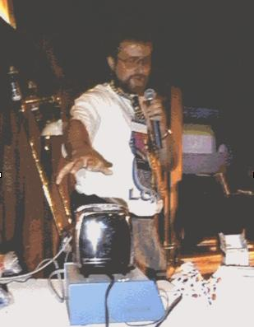
Notes:
https://cdn2.hubspot.net/hubfs/5300505/Imported_Blog_Media/toaster_simon2-2.jpg
demo at October '89 INTEROP conference

Slide 18
IOT a Brief History
2008-2009
According to Cisco, more “things or objects” are connected to the internet than people and
the Internet of Things is “born”.
Notes:
Harwood, Trevor https://www.postscapes.com/iot-history/ retrieved January 18, 2021

Slide 19
IOT a Brief History
2015
The Congressional Caucus on the Internet of Things is formed to keep lawmakers informed about the developing IOT industry.
Notes:
Harwood, Trevor https://www.postscapes.com/iot-history/ retrieved January 18, 2021

Slide 20
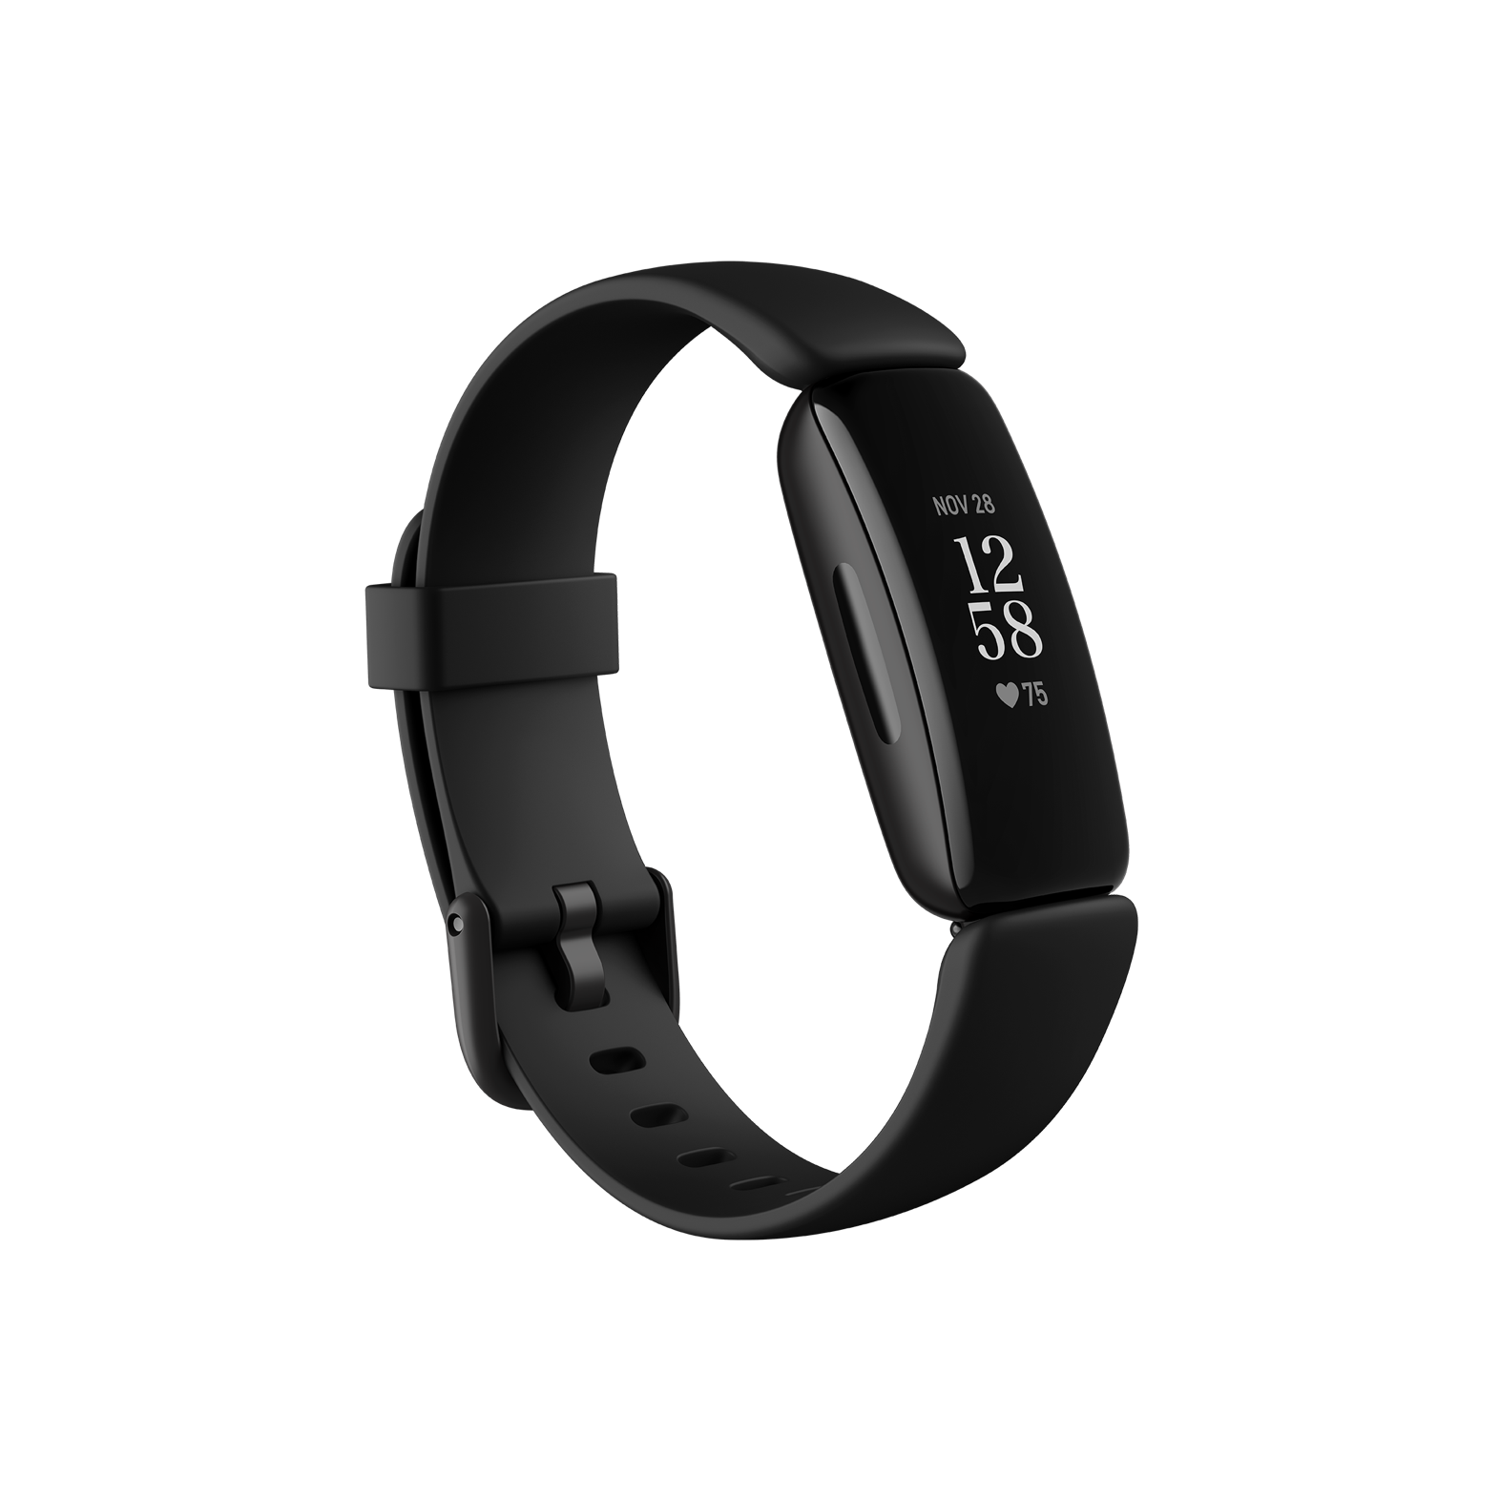
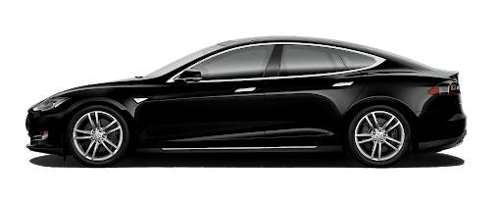
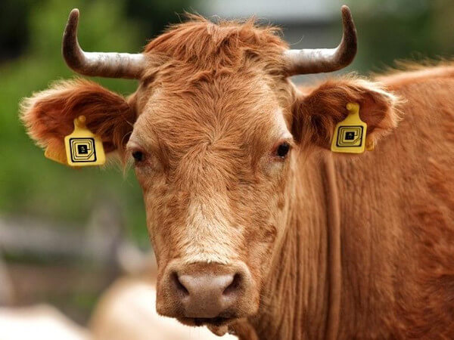
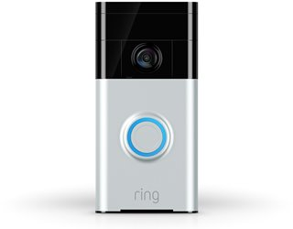
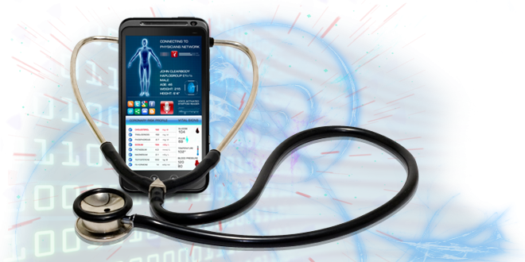
IOT Now
Notes:
https://internetofbusiness.com/iot-farm-cow-milking-robots/
fitbit.com
https://iotworm.com/internet-of-things-healthcare-devices/
tesla.com
ring.com

Slide 21
Why use IOT as a learning platform?

Slide 22
The present and future
In 2018—there were 7 billion IoT devices
In 2019—the number of active IoT devices reached 26.66 billion
Every second—127 new IoT devices are connected to the web
During 2020—experts estimate the installation of 31 billion IoT devices
By 2021—35 billion IoT devices will be installed worldwide
By 2025—more than 75 IoT devices billion will be connected to the web
Notes:
Maayan, G.D (2020). https://securitytoday.com/Articles/2020/01/13/The-IoT-Rundown-for-2020.aspx?Page=1&p=1 Accessed Jan 18, 2021

Slide 23
Why use IOT as a learning platform?
Might as well learn about a growing industry.

Slide 24
Show me the $$$
In 2016—the global spending on IOT was $737 billion
In 2018—the North American IOT market generated $83.9 billion in revenue
During 2020—global spending on IOT should reach $1.29 trillion
By 2021—the industrial IOT market size should reach $124 billion
By 2024—the global IOT healthcare market should reach $14 billion
By 2026—Experts estimate that the IOT device market will reach $1.1 trillion
Notes:
Maayan, G.D (2020). https://securitytoday.com/Articles/2020/01/13/The-IoT-Rundown-for-2020.aspx?Page=1&p=1 Accessed Jan 18, 2021

Slide 25
Why use IOT as a learning platform?
Might as well follow the money!

Slide 26
But, I am still confused…
What is IOT?
What is a THING?
Notes:
BY NOW - students might be convinced this is a good idea. Now we unfortunately must tell them that IOT is really a system of systems. There are many options which can be confusing and hard to implement without a well thought out plan.

Slide 27
In general, there are 3 types of
IOT devices (Things)
Devices that collect and send data.
Devices that receive and respond to data.
Devices that can do both.
Notes:
These devices are embedded systems, microcontrollers, single board computers which can be outfitted with sensors and actuators to collect information and respond to information.
Many devices which we might want to connect to the Internet are already running on embedded processors or microcontrollers. We need to securely connect these devices to the Internet to make them IOT “Things”.

Slide 28
Devices that collect and send data.
A remote weather station.
A motion tracker attached to a cow.
A personal fitness tracker, e.g. FitBit

Slide 29
Devices that receive and respond to data.
A remote controlled light.
An emergency shut off switch on an industrial machine.
A remote controlled door lock .

Slide 30
Devices that both collect and send data, and receive and respond to data.
A Tesla.
A greenhouse automation system.
A “smart” pill bottle.
Notes:
Tesla -obvious
Can send current conditions to central monitoring location. Can get updated control parameters, e.g. temperature, light levels from central monitoring location.
Smart pill bottles keep track of when they are opened and close. Can alert patient via text, blinking bottle cap, etc. if they forgot to take their medication.

Slide 31
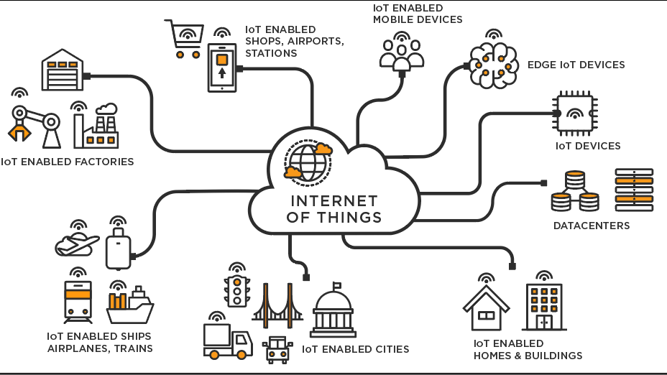
Note: From https://www.tibco.com/sites/tibco/files/media_entity/2020-05/IoT.png
Notes:
IOT is finding applications in a wide variety of industries! Why? There are PROBLEMS everywhere that need help.
https://www.tibco.com/sites/tibco/files/media_entity/2020-05/IoT.png

Slide 32
A BIG PICTURE view of IOT.

Slide 33
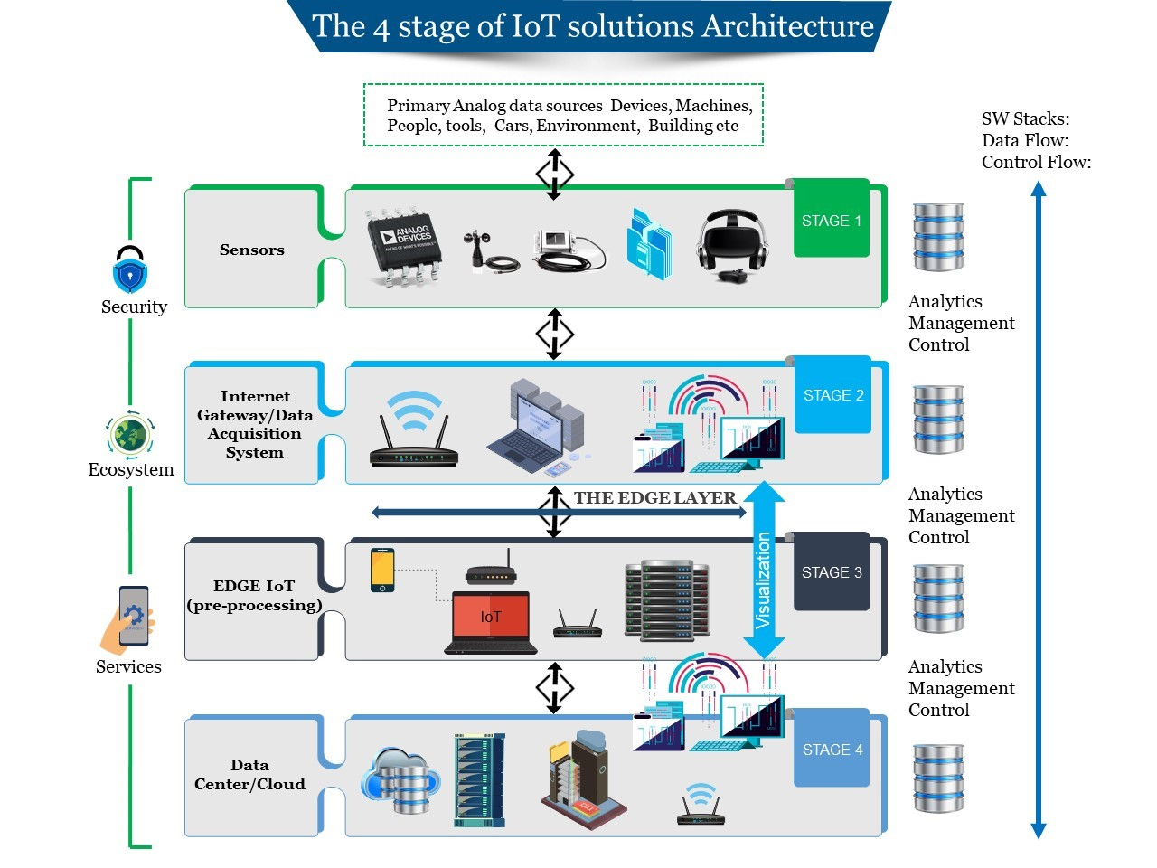
Note: From https://www.marlabs.com/blog-stages-of-iot-architecture/stages-of-iot-architecture/
Notes:
https://www.marlabs.com/blog-stages-of-iot-architecture/stages-of-iot-architecture/

Slide 34
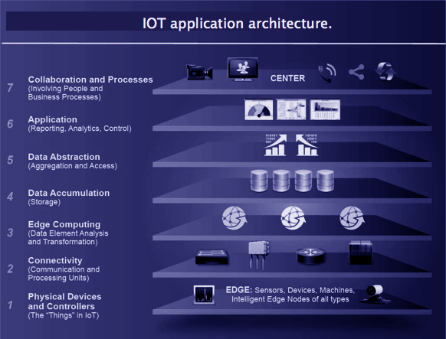
https://www.marlabs.com/blog-stages-of-iot-architecture/stages-of-iot-architecture/
Note: From https://data-flair.training/blogs/iot-architecture/
Notes:
https://data-flair.training/blogs/iot-architecture/

Slide 35
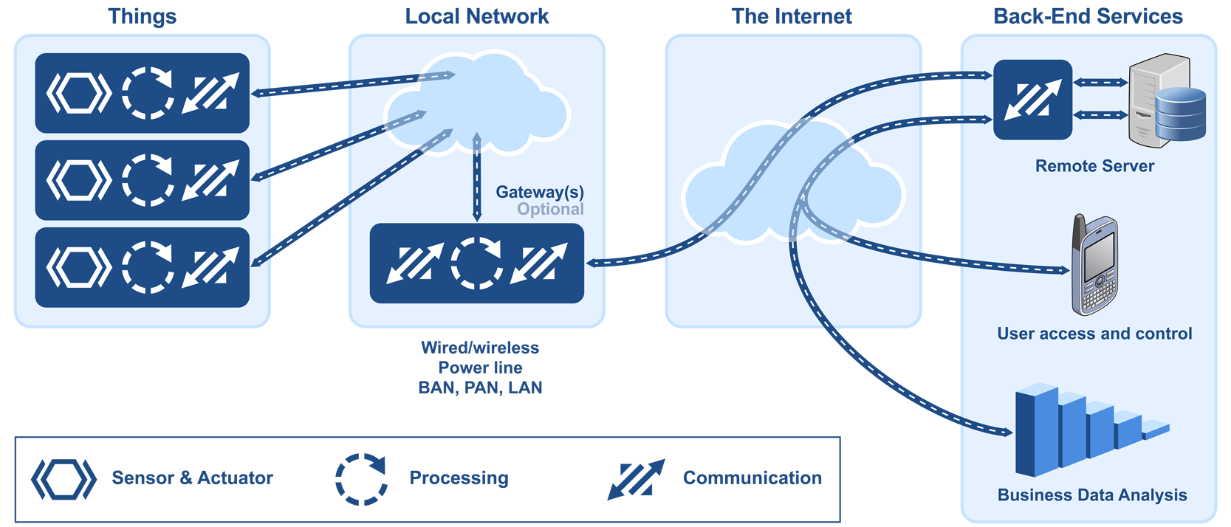
Note: From https://grayhats.in/how-dose-iot-work/
Notes:
https://grayhats.in/how-dose-iot-work/

Slide 36
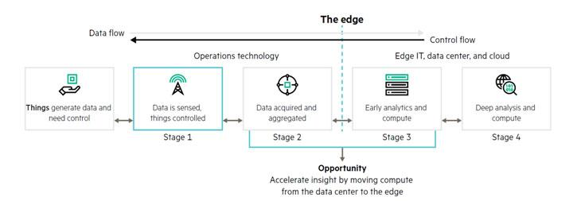
https://grayhats.in/how-dose-iot-work/
Note: From https://data-flair.training/blogs/iot-architecture/

Slide 37
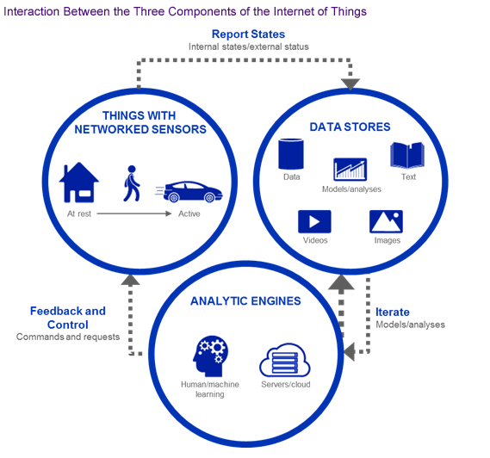
Note: From https://data-flair.training/blogs/iot-architecture/
Notes:
https://data-flair.training/blogs/how-iot-works/

Slide 38
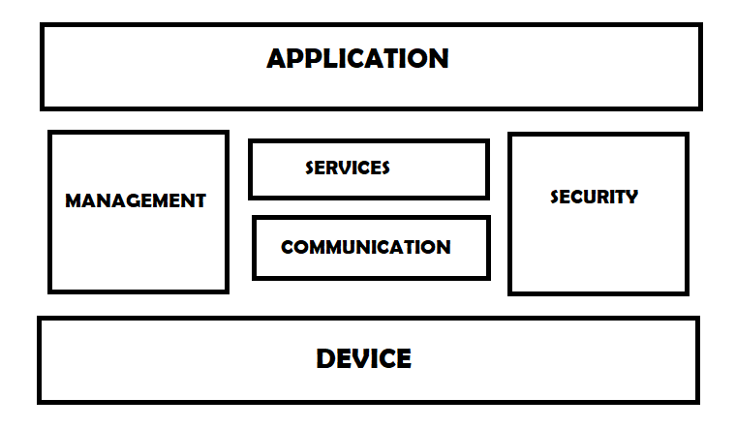
Note: From https://iotbyhvm.ooo/logical-design-of-iot/
Notes:
https://iotbyhvm.ooo/logical-design-of-iot/

Slide 39
What is the BIG PICTURE
view of IOT?
It depends who you ask.

Slide 40
Bottom line - IOT is a complex
System of Systems
The remainder of Unit 1 will highlight some different system requirements to create a functioning IOT system.

Slide 41
Unit 1 Topics
1.1 What is IOT? What is a Thing? ✔
1.2 IOT Connectivity
1.3 IOT Communication Protocols
1.4 IOT Services
1.5 IOT Security
1.6 IOT Power

